Slide 1

Birla Institute of Technology,
Mesra, Ranchi - 835215 (India)
Department of Computer Science and Engineering
CA545 Natural Language Processing
Presentation on
Sentiment Analysis on Real Phone Calls
Presented To :
Presented By :
Dr. Shruti Garg
(Asst. Prof.)
Group Members
1. | Lucky Verma | MCA/10062/22
2. | Dewesh Chopra | MCA/10032/22
3. | Sameer Horo | MCA/10063/22
4. | Ankit Kumar Pandey | MCA/10065/22

Slide 2
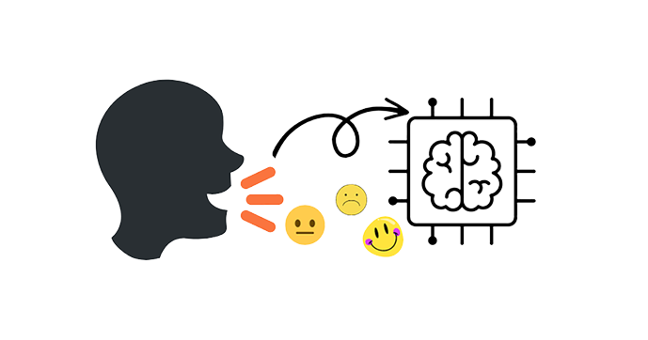
Introduction
Sentiment Analysis
Definition: Sentiment analysis, or opinion mining, involves evaluating
text to identify and understand sentiments,
whether positive, negative, or neutral, to extract insights from expressed opinions.
Purpose: It helps to comprehend and quantify emotions expressed in text, enabling businesses to gauge public opinion, customer satisfaction, and brand perception.
Inventors:
Gerald Salton: Considered a pioneer in sentiment analysis, Salton made significant contributions to the field in the 1980s.
Bo Pang and Lillian Lee: Their influential research in the early 2000s laid the foundation for key methodologies and principles in sentiment analysis.
Process: Utilizes natural language processing, machine learning, and AI algorithms to categorize and analyze sentiments, providing valuable insights from text data.
Applications: Used in customer service, social media monitoring, market research, brand management, and product development to make informed decisions based on public sentiments.
Advancements: Constant improvements in machine learning and deep learning techniques enhance the accuracy and depth of sentiment analysis.

Slide 3
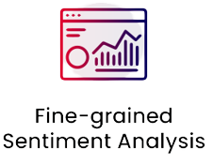
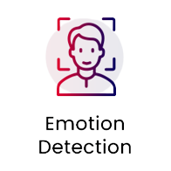
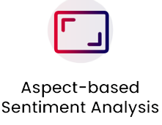

Types Of Sentiment Analysis
The sentiment analysis process mainly focuses on polarity, i.e., positive, negative, or neutral. Apart from polarity, it also considers the feelings and emotions(happy, sad, angry, etc.), intentions(interested or not interested), or urgency(urgent or not urgent) of the text.
If your business requires the polarity precisions, then you can classify your polarity categories into the following parts: [Very positive, Positive, Neutral, Negative, Very Negative ]
For polarity analysis, you can use the 5-star ratings as a customer review
where very positive refers to a five-star rating and very negative refers to a one-star rating.
1.
2.
It helps to detect customer emotions like happiness, disappointment, anger, sadness, etc. Here, you can use sentiment lexicons or complex machine learning algorithms to identify the feelings.
DISADVANTAGES: using sentiment lexicons it may be confusing to understand human emotion.
3.
Aspect-based sentiment analysis extracts specific aspects or features that customers mention in their reviews, categorizing sentiments as positive or negative for each identified aspect.
Multilingual sentiment analysis is complex compared to others as it includes many preprocessing and resources available online (i.e., sentiment lexicons).
Businesses value the feedback of the customer regardless of their geography or language.
Therefore, It helps you identify customer sentiment irrespective of location or language difference.
4.

Slide 4
Sentiment Analysis on Real Phone Calls
Project Purpose:
The primary objective of this project is to develop a system capable of extracting sentiment from spoken language, specifically phone call conversations.
By understanding the sentiment of the conversation between 2 Person on call , we aim to gain insights into persons overall sentiments trends.
Tools and Libraries Used:
Tkinter: Integrated into the project to enhance the user interface, Tkinter provided an interactive platform for visualizing sentiment data and creating a user-friendly experience.
Speech Recognition: we implemented a speech recognition library to convert spoken language into text for further analysis.
Matplotlib: Employed for generating bar graphs, Matplotlib was used to visualize the sentiment analysis results, providing an intuitive means to compare and contrast sentiment scores.

Slide 5
Flow-Chart of Sentiment Analysis on Real Phone Calls
Start
Extract Valid Tokens which exert emotions
Sentiment_Analysis
Upload Audio
Record Audio
Audio_Processing
Create a Dictionary with Key as Tokens and Value
Audio Processing on
Uploaded File / Recorded File
Visualizations
Store the transcribed_text.txt
Plot Emotion Distribution
Text_Preprocessing
Obtain Count Of Each Emotion
Convert Text to Lowercase
Plot Polarity And Subjectivity
Obtain a final list of Valid Tokens
Remove Punctuations
Calculate Polarity And Subjectivity
Tokenization
Stop
Remove Stop Words

Slide 6
Process of Sentiment Analysis on Real Phone Calls
Data Collection Process:
The success of our sentiment analysis project relies heavily on the quality and relevance of the data we collect from phone calls.
Methods of Data Collection:
Call Recording: We recorded phone calls between 2 friends or people.
Transcription: The recorded calls were then transcribed into text format using our speech recognition component. This step was crucial in preparing the data for sentiment analysis.
Speech Recognition: Speech recognition is a crucial component of our project. It enables us to convert spoken language from phone calls into text format, which can then be further analyzed for sentiment.
How Speech Recognition Works:
Audio Input: The process starts with receiving audio data from phone calls. This can be in the form of recorded audio files or real-time streaming.
Decoding: Using both acoustic and language models, the system decodes the audio input into a sequence of words or tokens.
Output Text: The result is a text representation of the spoken language, which can be used for further analysis.

Slide 7
How Sentiment Analysis Works
Text Preprocessing: Before analysis, the text data undergoes preprocessing steps like tokenization, removing punctuation, and converting to lowercase.
Feature Extraction: Relevant features, such as words or phrases, are extracted from the preprocessed text. These features are used to identify patterns associated with sentiment.
Sentiment Classification: We used Lexicon Sentiment Analysis the extracted features are used to classify the sentiment into categories sad, angry, happy etc.
Visualization : Data visualization is a crucial aspect of our project. It allows us to present the results of our sentiment analysis in a clear and understandable format.
Emotion distribution: Shows the distribution plot of emotions present in the phone call.
Polarity and Subjectivity plot: Shows the value of polarity and subjectivity.

Slide 8
In sentiment analysis, polarity and subjectivity are two metrics used to assess the sentiment expressed in a given text.
Polarity
Subjectivity
Polarity quantifies the sentiment orientation expressed in the text, whether it's positive, negative, or neutral. It typically ranges from -1 to 1:
-1 denotes extremely negative sentiment.
0 denotes a neutral sentiment.
1 denotes extremely positive sentiment.
Subjectivity measures how subjective or opinionated the text is, reflecting the degree to which the text expresses personal opinions, feelings, or biases rather than factual information. The typical range for subjectivity is from 0 to1:
0 denotes an objective or factual statement.
1 denotes highly subjective or opinionated text.
Formula for Polarity
The formula for polarity is often calculated by dividing the number of emotional words (positive or negative) by the total number of words in the text:
Formula for Subjectivity
The formula for subjectivity varies across approaches. A common formula involves the count of unique emotional words divided by the total count of emotional words:
Polarity= Total number of words /
Number of emotional words​
Subjectivity= Number of unique emotional words /
Total number of emotional words​

Slide 9
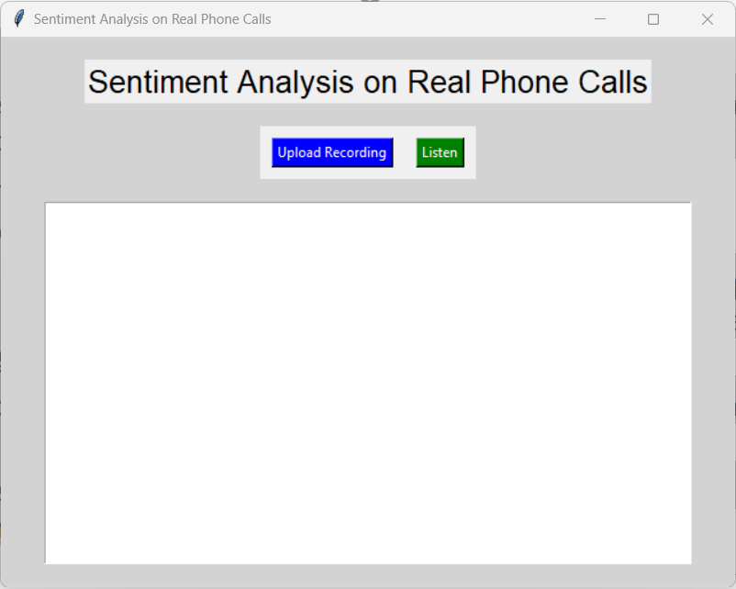
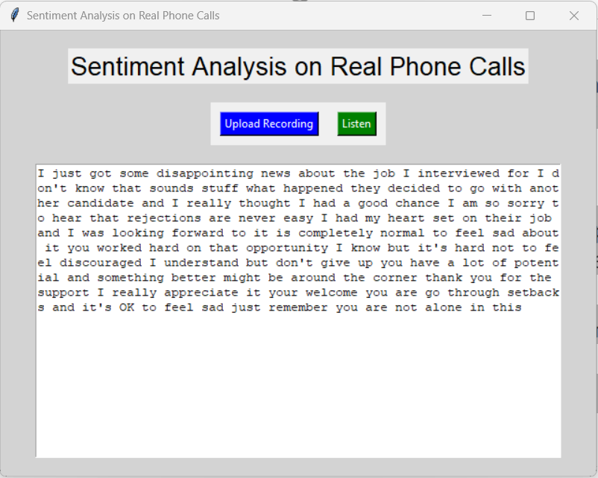
Output:
Main GUI
Transcribed Text Generated
in text_display

Slide 10
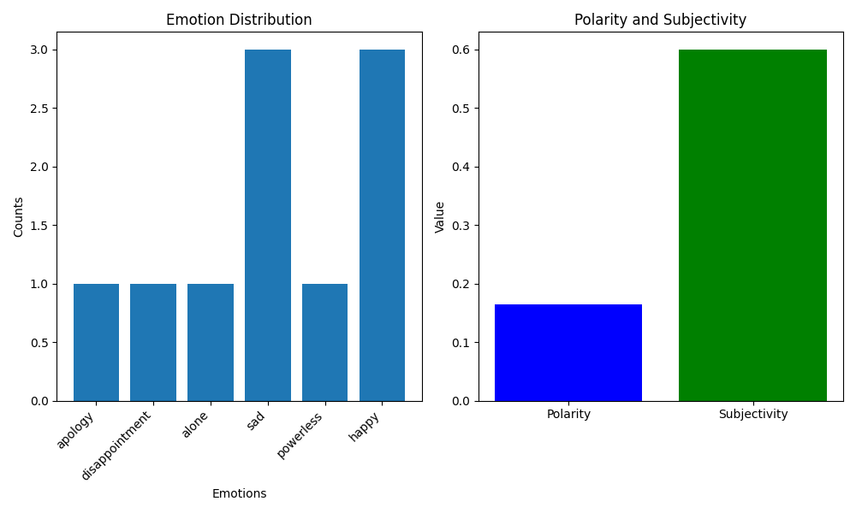
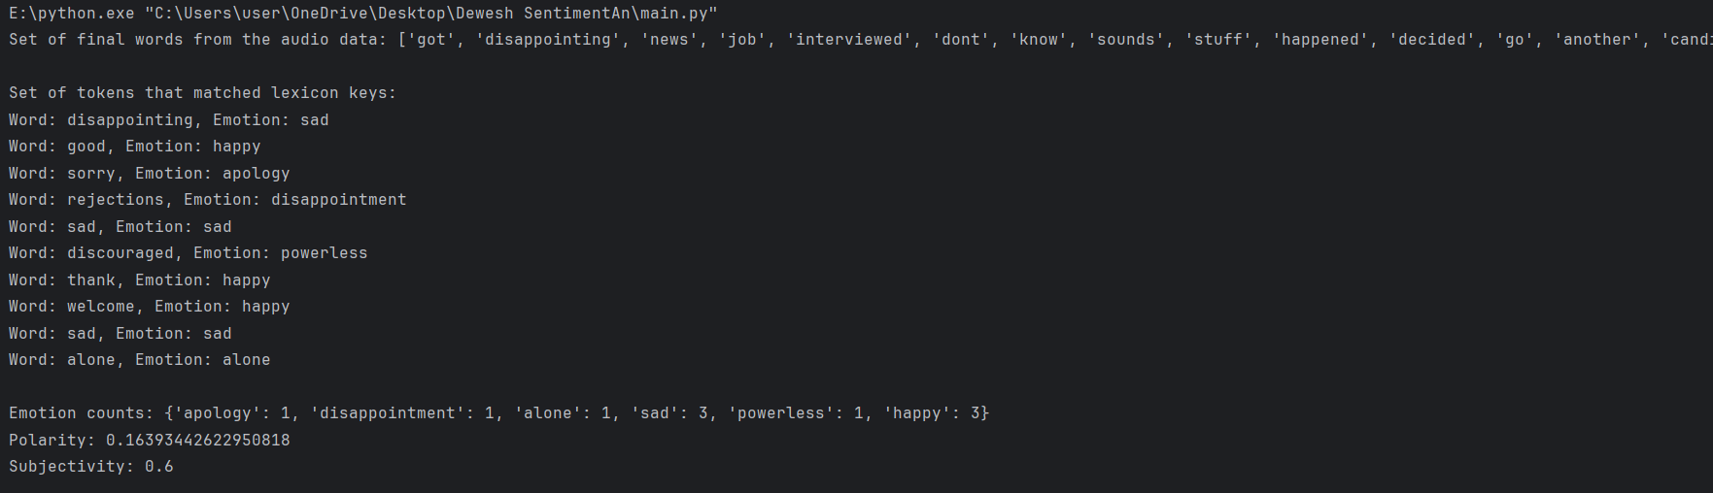
Output: Emotion Distribution & (Polarity & Subjectivity)
OUTPUT
Set of Final Words
Set of Tokens
Emotion Counts
Polarity & Subjectivity

Slide 11




Applications of Sentiment Analysis on Real Phone Calls
Customer Service: Analyzing sentiment in customer service calls can help assess customer satisfaction, detect dissatisfaction or frustration, and identify trends in queries or complaints. This analysis enables companies to enhance their services and improve customer experience.
Market Research & Analysis: Analyzing sentiments in phone calls provides valuable insights into market trends, customer preferences, and feedback on products or services. It assists in market research efforts, enabling companies to adapt offerings based on customer sentiments.
Fraud Detection: In financial services, sentiment analysis can help in identifying fraudulent calls by analyzing voice tones and expressions, potentially uncovering suspicious behavior or irregularities.
Emotionally Intelligent Chatbots: Sentiment analysis on calls can aid in training AI-driven chatbots to understand and respond appropriately to the emotional context of customer inquiries or issues.

Slide 12
Future Scope of Sentiment Analysis on Real Phone Calls
Contextual understanding in sentiment analysis on phone calls is a developing area for improvement.
Advancements in technology, including machine learning and NLP, strive to better grasp the context of conversations to interpret sentiments accurately.
Identifying the polarity (positive, negative, neutral) in these contexts is essential for gauging customer sentiments during calls.
Irony and sarcasm recognition in context can significantly impact polarity detection in sentiment analysis.

Slide 13
Thank You

